Slide 1
Williams international data transformation project
Simon lidwell

Slide 2
Agenda
Organization/Industry Description
Problem Description
Problem Solution
Evaluation of Potential Solutions
Business Benefits
Conclusion

Slide 3
Williams international
Aerospace
Manufacturing
Commercial
Defense

Slide 4
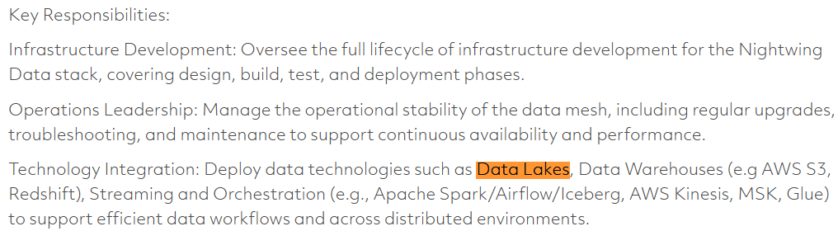
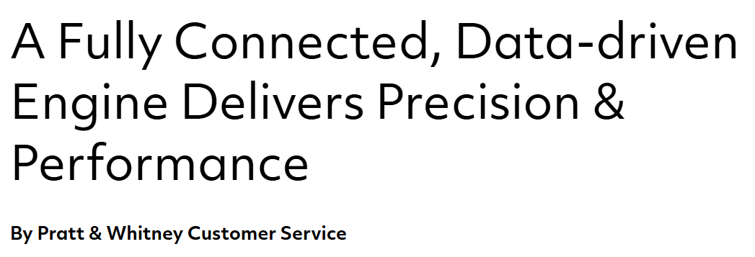
What we’re dealing with
Competitors:
Raytheon
Pratt & Whitney
Notes:
https://careers.rtx.com/global/en/job/01736702/Data-Infrastructure-Lead#:~:text=Infrastructure%20Development:%20Oversee%20the%20full,retrieval%20speed%2C%20and%20system%20resilience.
https://www.prattwhitney.com/en/blogs/airtime/2017/05/29/a-fully-connected-data-driven-engine-delivers-precision-and-performance#:~:text=Empowerment%20Through%20Data:%20the%20Future%20is%20Now&text=While%20you%20are%20piloting%20a,by%20dispatching%20a%20needed%20part.&text=You%20are%20an%20operator%20on,the%20Connected%20Engine%20video%20below.

Slide 5
Problem description
Williams International is pursuing a digital transformation of their business, yet several data-related challenges hinder their ability to leverage modern insights
Problem | What is it? | Why is it a problem?
Siloed data across systems
Complex data types for modern manufacturing
Legacy data trapped in unstructured formats

Slide 6
THANK YOU
Simon Lidwell​
slidwell@oakland.edu

